Slide 1






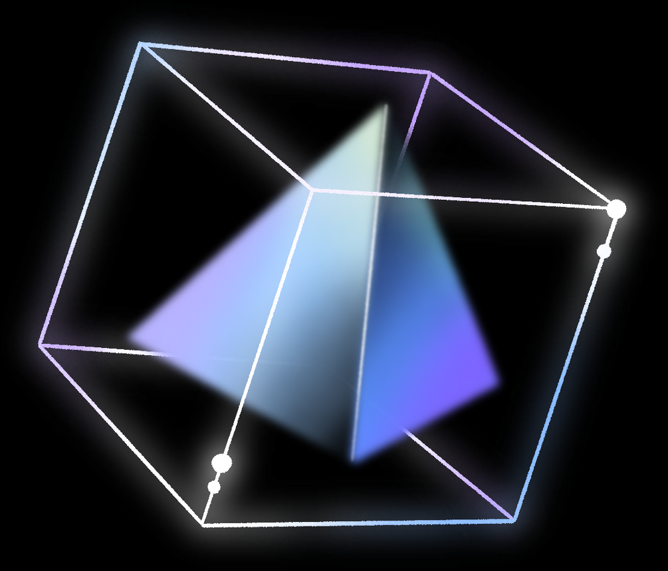
02
THÁI THÀNH PHÁT
ITITIU21274
DSA Project
01
MINESWEEPER
04
VÕ HOÀI BẢO
ITITIU21038
PHẠM TRUNG DŨNG
ITITIU21007
03
NGUYỄN ĐỨC DUY
ITITIU21008

Slide 2




CONTRIBUTOR
Tools
DSA Project
01
02
03
04
05
06
07
NGUYỄN ĐỨC NGUYÊN PHÚC
ITDSIU21108
IntelliJ IDEA
GITHUB
ECLIPSE IDE
MINESWEEPER
By Group “JQKA”
Introduction
Game Rules
UML & Git
Data Structure & Algorithm
Features & Design Pattern
Demo
Q&A
Introduction
Game Rules
Git
Data Structure & Algorithm
UML & Other classes
Demo
Q&A

Slide 3
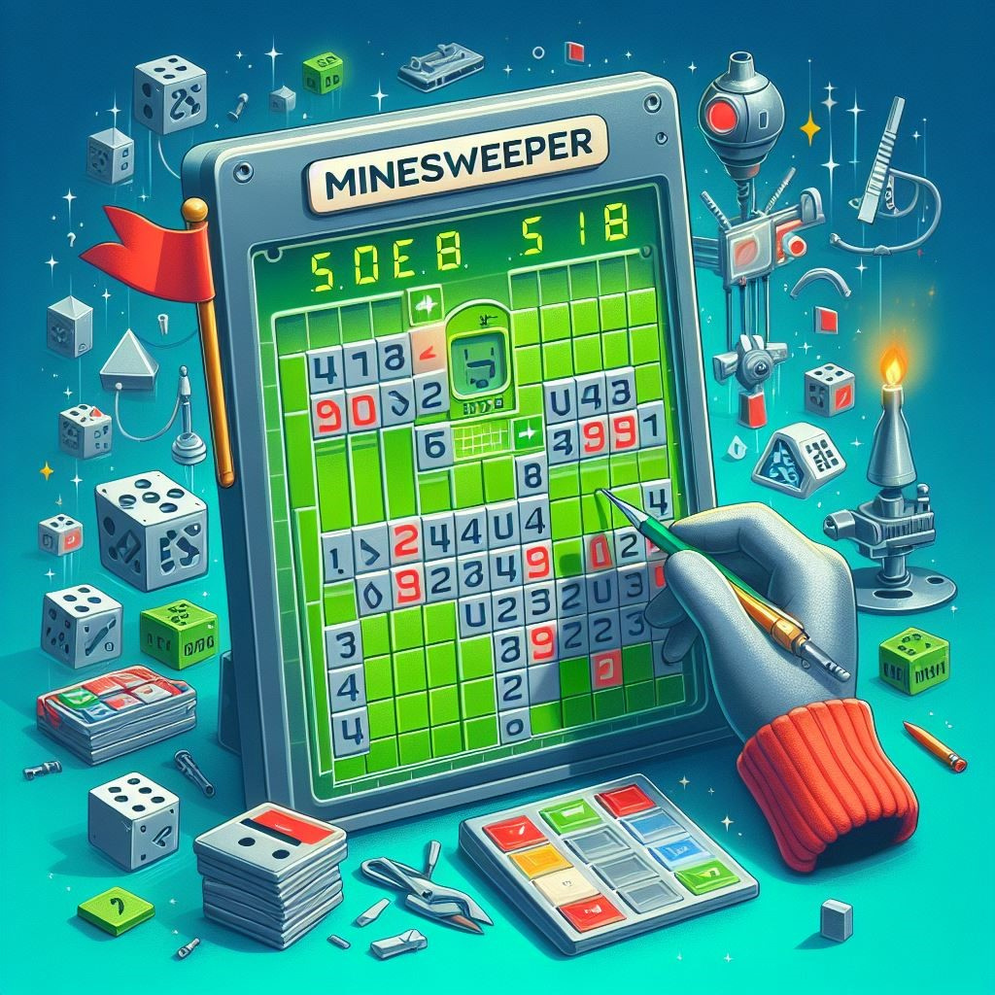



TABLE OF CONTENTS
Introduction
Game Rules
UML & Git
Data Structure & Algorithm
Features & Design Pattern
Demo
Q&A
01
02
03
04
05
06
07
01
02
03
04
VÕ HOÀI BẢO
ITITIU21038
THÁI THÀNH PHÁT
ITITIU21274
NGUYỄN ĐỨC DUY
ITITIU21008
PHẠM TRUNG DŨNG
ITITIU21007
INTRODUCTION
CODED BY JAVASCRIPT
- A Childhood game.
- Use intelligence to figure out the bombs.

Slide 4
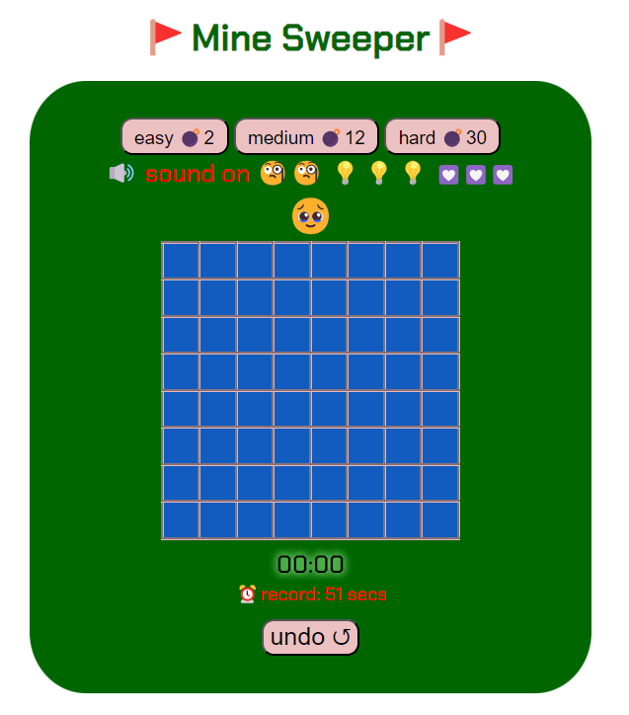


Introduction
Game Rules
UML & Git
Data Structure & Algorithm
Features & Design Pattern
Demo
Q&A
01
02
03
04
05
06
07
- Left Click to unlock a square
- Right Click to place a flag
- Click on the bomb -> LOSE !
INTRODUCTION
CODED BY JAVA
A game of logic.
Make use of your intelligence to locate the mines.
GAME RULES
TABLE OF CONTENTS

Slide 5


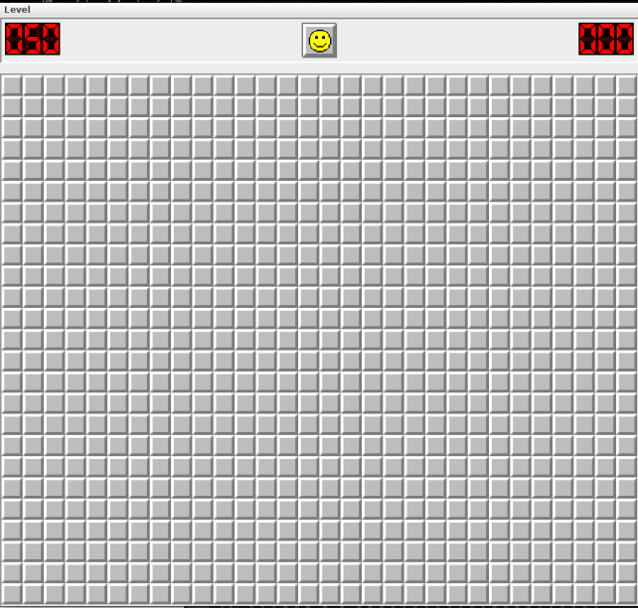
GAME RULES
Right Click to reveal a cell
Left Click to place a flagging or unflagging
Click on the bomb -> LOSE !
3 Levels: Beginner, Intermediate and Hard

Slide 6
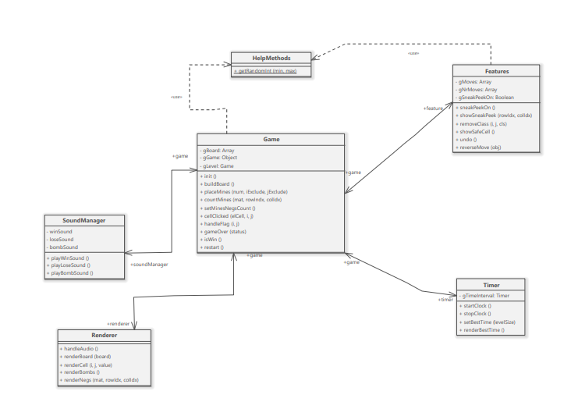


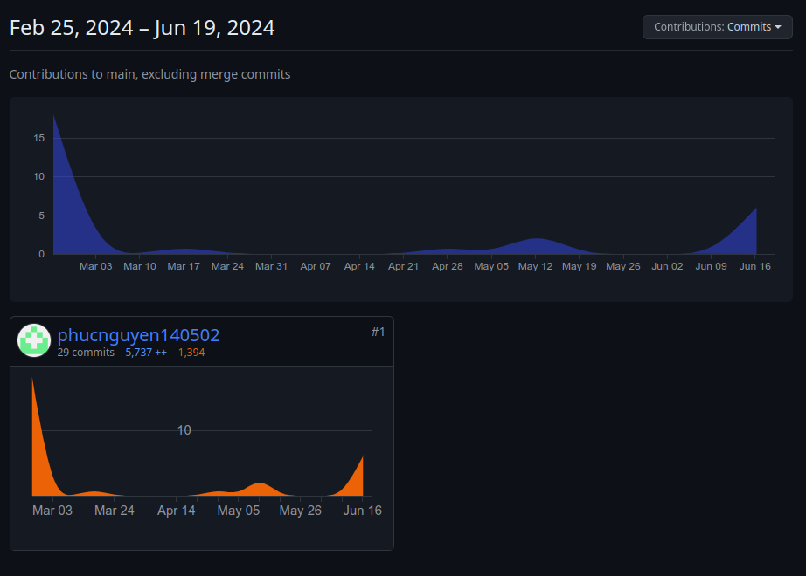

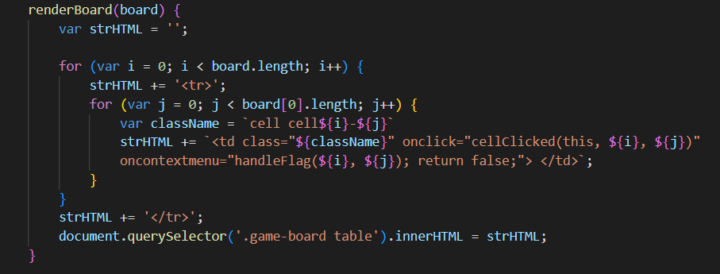

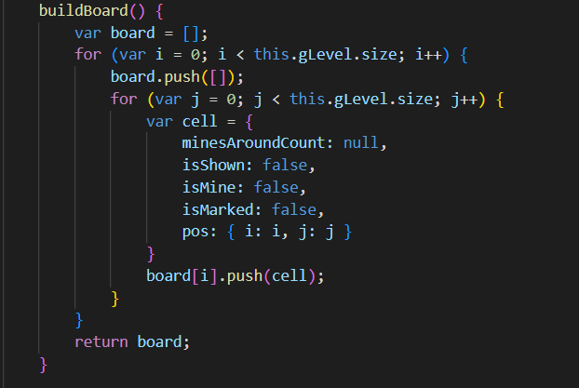

DATA STRUCTURE & ALGORITHM
GIT CONTRIBUTION
01
02

Slide 7
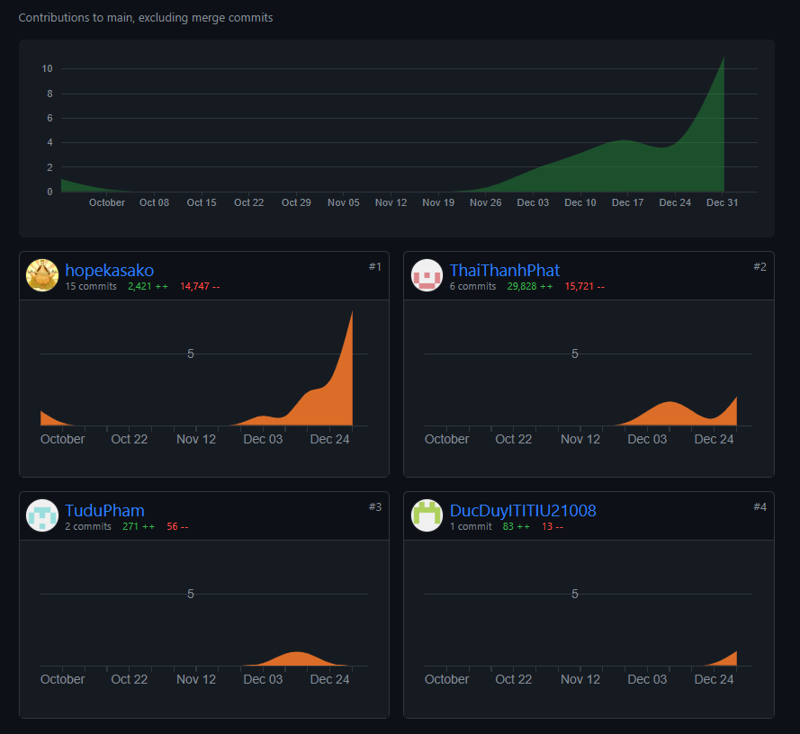
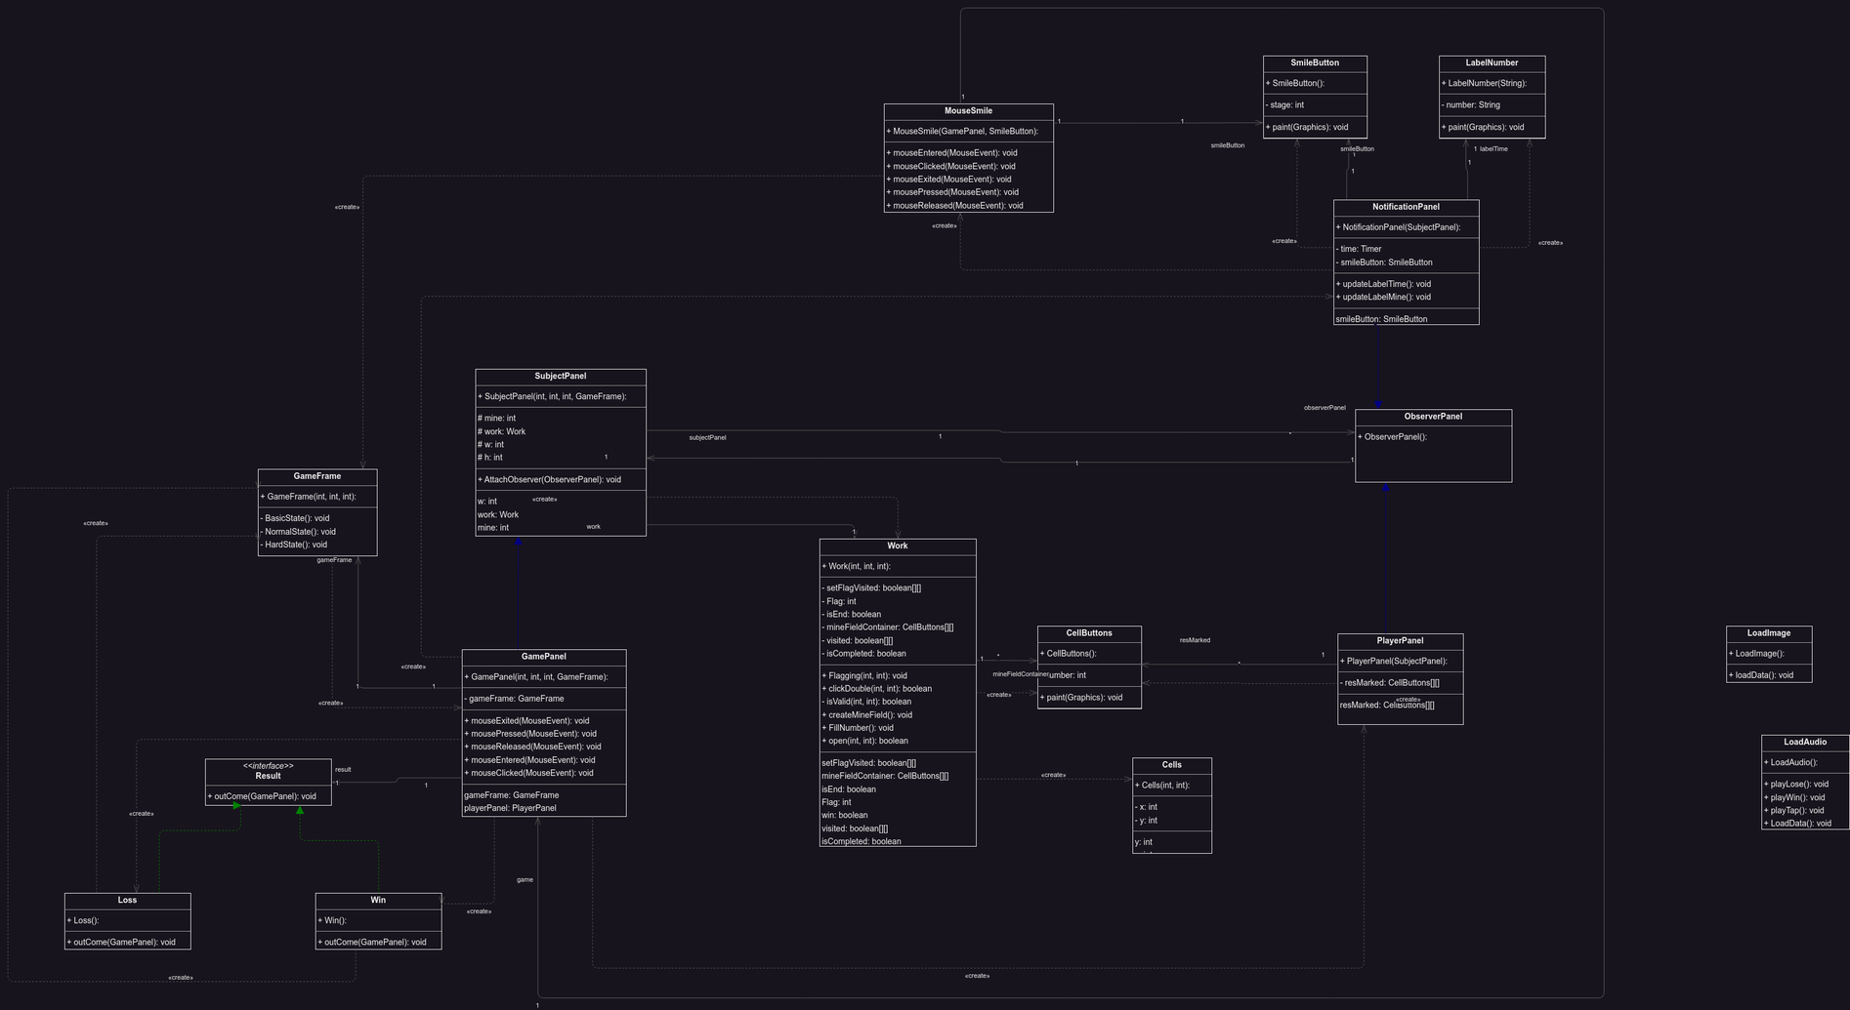
DATA STRUCTURE & ALGORITHM
UML
- Left Click to unlock a square
- Right Click to place a flag
- Click on the bomb -> LOSE !
GIT CONTRIBUTION
Time complexity : O(N^2)

Slide 8

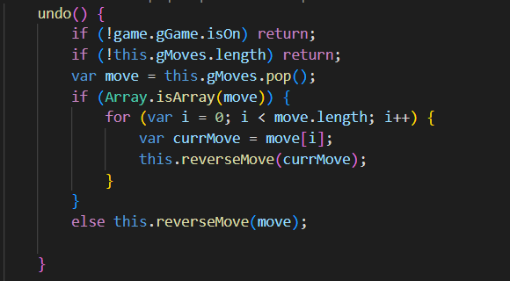
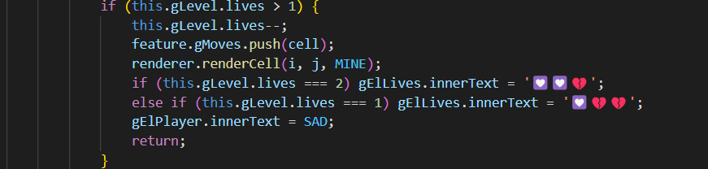
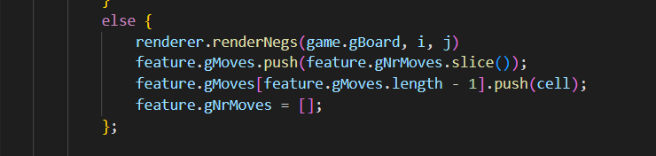
DATA STRUCTURE & ALGORITHM
DATA STRUCTURE & ALGORITHM
Applying Advanced Graph (BFS)
The algorithm in class work
click work.java to see
Time complexity : O(N^2)
GIT CONTRIBUTION

Slide 9
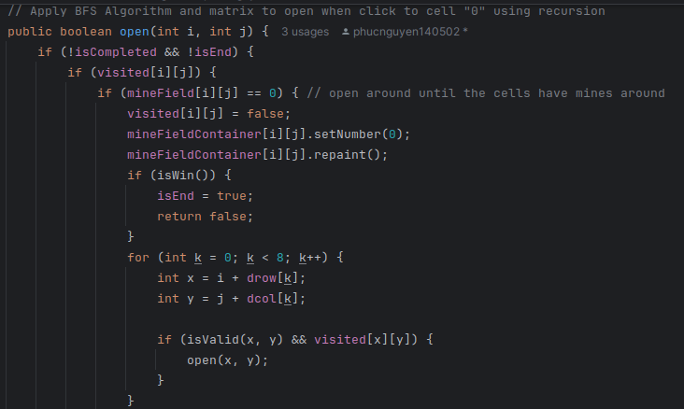
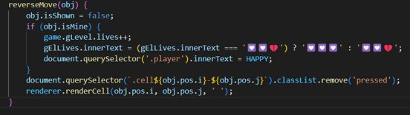
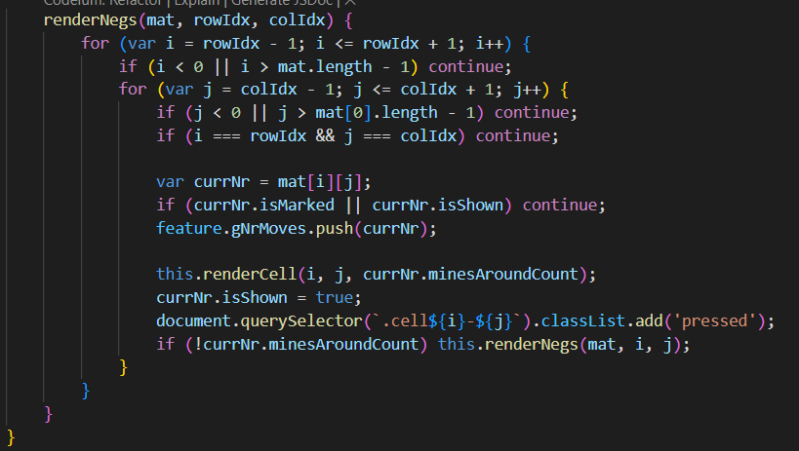
DATA STRUCTURE & ALGORITHM
DATA STRUCTURE & ALGORITHM
Applying Recursion
Time Complexity : O(N^2)
DATA STRUCTURE & ALGORITHM

Slide 10
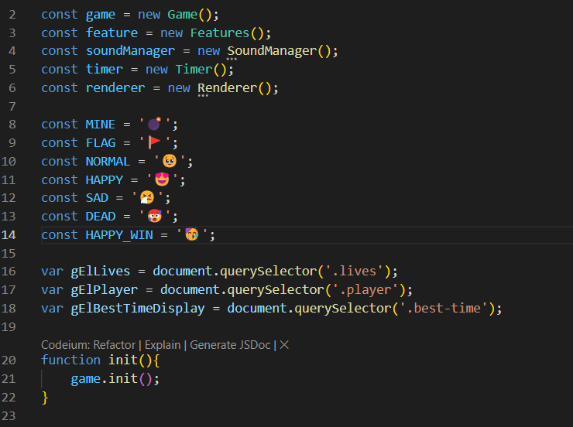
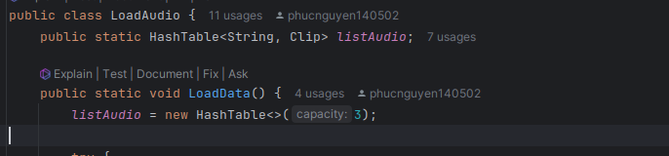
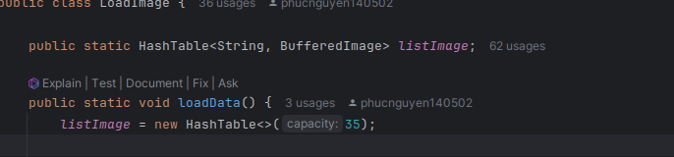
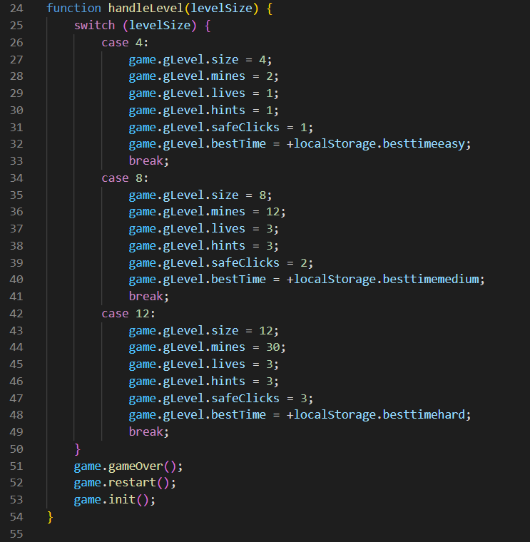
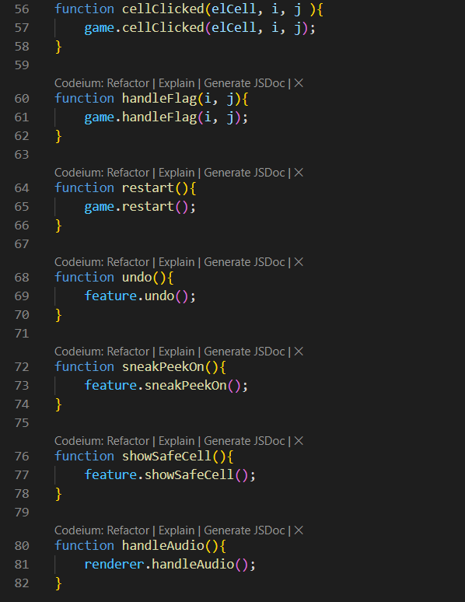
Time Complexity : O(1)
script.js
DATA STRUCTURE & ALGORITHM
Applying HashTable
DATA STRUCTURE & ALGORITHM

Slide 11
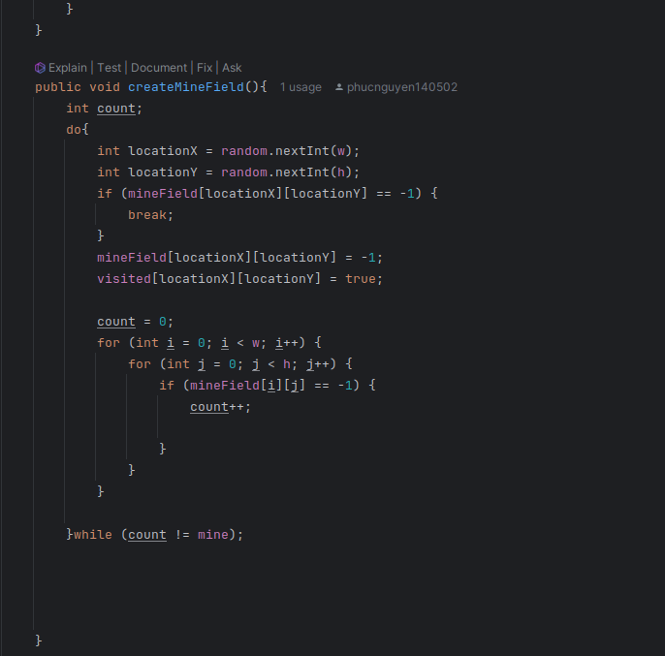
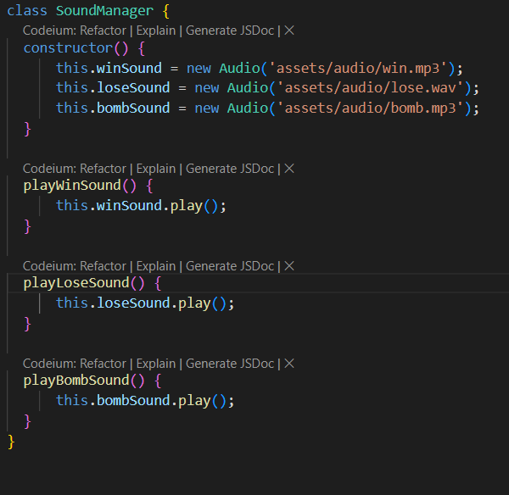
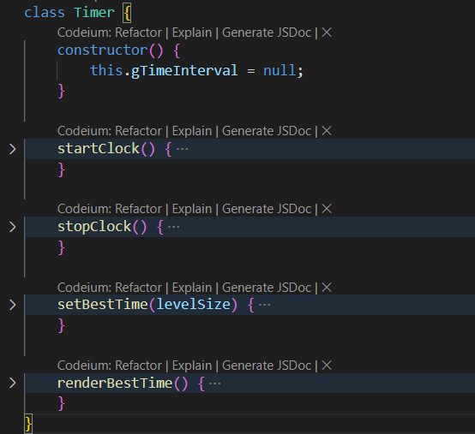
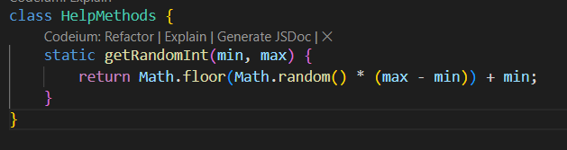




Create the board
Other Classes

Slide 12
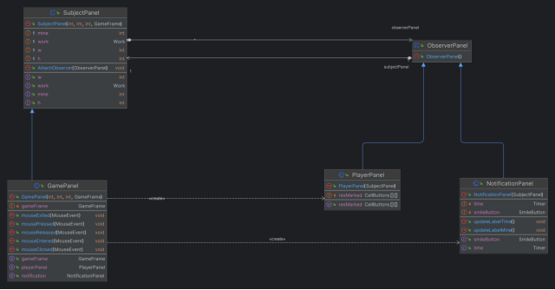
Observer Design Pattern

Slide 13
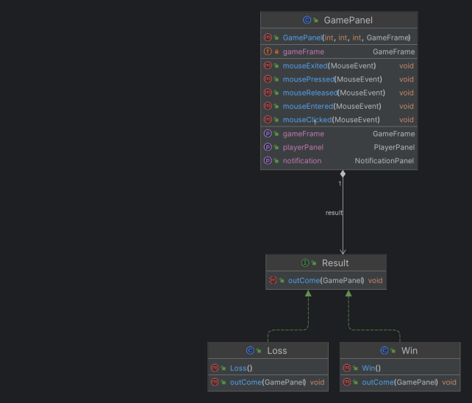
Strategy Design Pattern

Slide 14


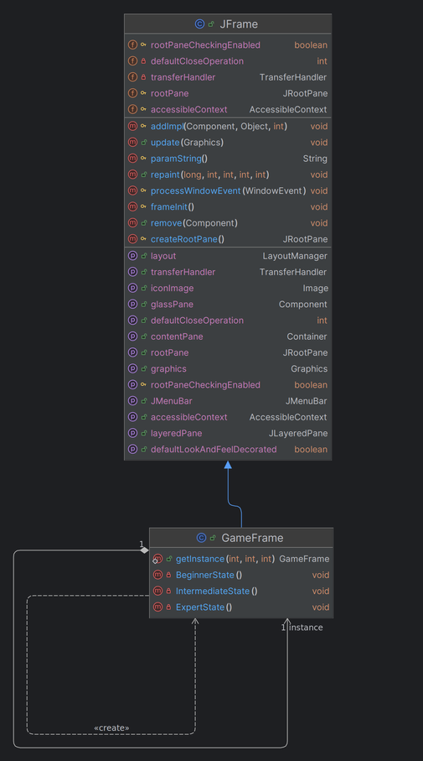
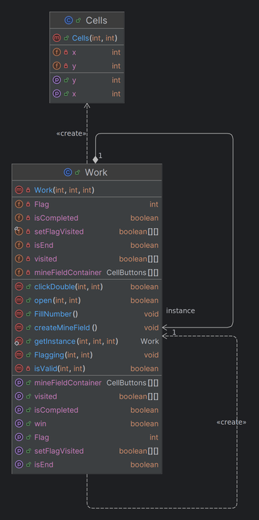



Singleton Pattern
GAME DEMO

Slide 15

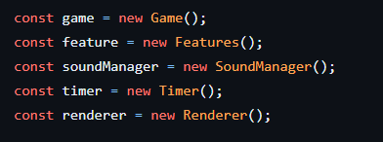
THANK YOU
FOR LISTENING !
GAME DEMO
Singleton Pattern
Q&A TIME!

Slide 16
02
THÁI THÀNH PHÁT
ITITIU21274
Thank you for listening
01
04
VÕ HOÀI BẢO
ITITIU21038
PHẠM TRUNG DŨNG
ITITIU21007
03
NGUYỄN ĐỨC DUY
ITITIU21008
Q&A TIME!

Slide 17




RESOURCE PAGE

